Slide 1






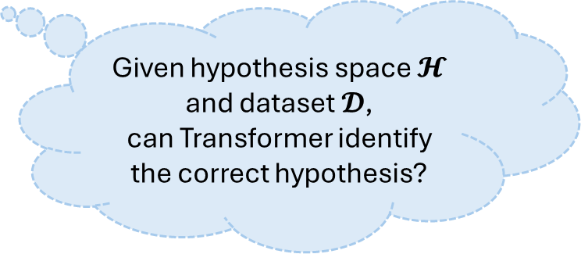



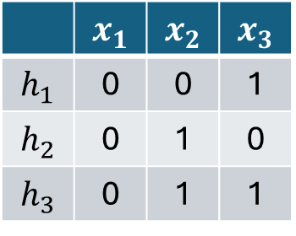


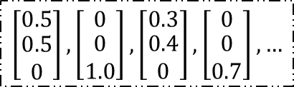
Type 1: Unaligned Sequence
Type 2: Aligned Sequence
0
1
2
$$y^{(k)}=f(x^{(k)})$$
1,0,2,2,1,2,…
$$x^{(k)}$$
$$x^{(k)}$$
Common-used
or
Transformer
$$\left[\begin{matrix}0.5 \\ \begin{aligned}0.5 \\ 0\end{aligned}\end{matrix}\right],\left[\begin{matrix}0 \\ \begin{aligned}0 \\ 1.0\end{aligned}\end{matrix}\right],\left[\begin{matrix}0.3 \\ \begin{aligned}0.4 \\ 0\end{aligned}\end{matrix}\right],\left[\begin{matrix}0 \\ \begin{aligned}0 \\ 0.7\end{aligned}\end{matrix}\right],…$$
Transformer
$$\left[\begin{matrix}0.5 \\ −0.5\end{matrix}\right],\left[\begin{matrix}0.5 \\ 0.5\end{matrix}\right],\left[\begin{matrix}0.5 \\ −0.5\end{matrix}\right],…$$
$$x^{(k+1)}=f(x^{(k)})$$
$$x^{\left(1\right)},x^{\left(2\right)},x^{(3)},…,x^{(k−1)}$$
$$x^{\left(1\right)},y^{\left(1\right)},x^{\left(2\right)},y^{(2)},…,x^{(k)}$$
$$𝓗=\{h_{1},h_{2},h_{3}\}$$
$$h_{?}$$
Given hypothesis space $𝓗$
and dataset $𝓓$,
can Transformer identify the correct hypothesis?
 | $$x_{1}$$ | $$x_{2}$$ | $$x_{3}$$
$$h_{1}$$ | 0 | 0 | 1
$$h_{2}$$ | 0 | 1 | 0
$$h_{3}$$ | 0 | 1 | 1
Transformer
Ours
hypothesis prefix
$$x^{\left(1\right)},y^{\left(1\right)},x^{\left(2\right)},y^{(2)},…,x^{(K)},y^{(K)}>$$
$$𝓓={\left\{(x^{\left(k\right)},y^{(k)})\right\}}_{k=1}^{K}$$

